Slide 1

Using the Updated Groundwater Monitoring Worksheet
http://deq.mt.gov/DEQAdmin/PET/forms

Slide 2
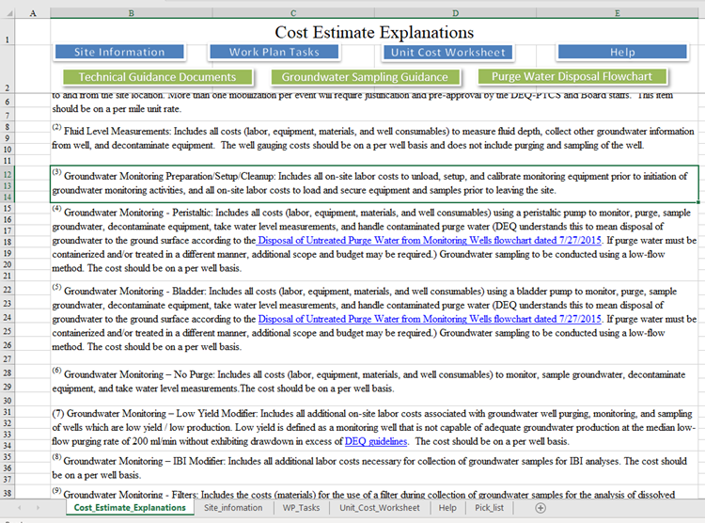

Slide 3
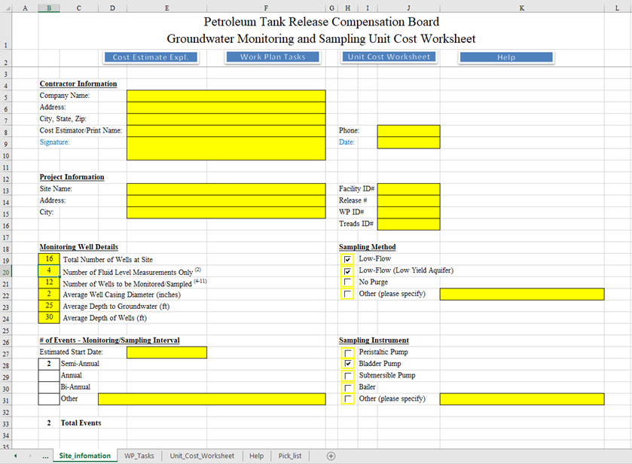

Slide 4
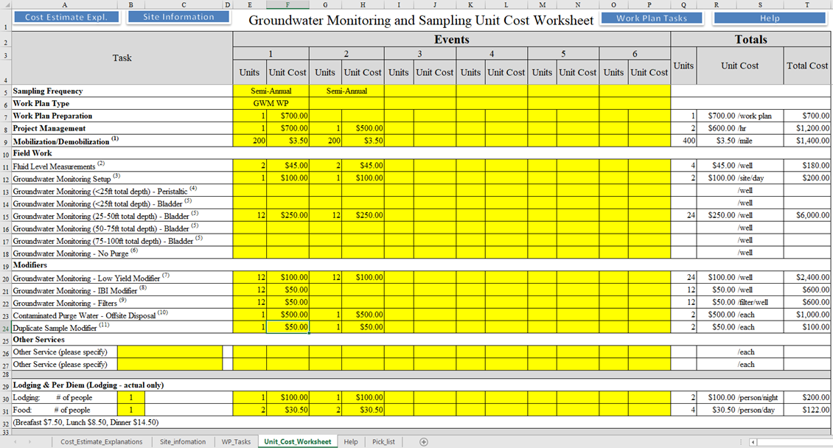

Slide 5
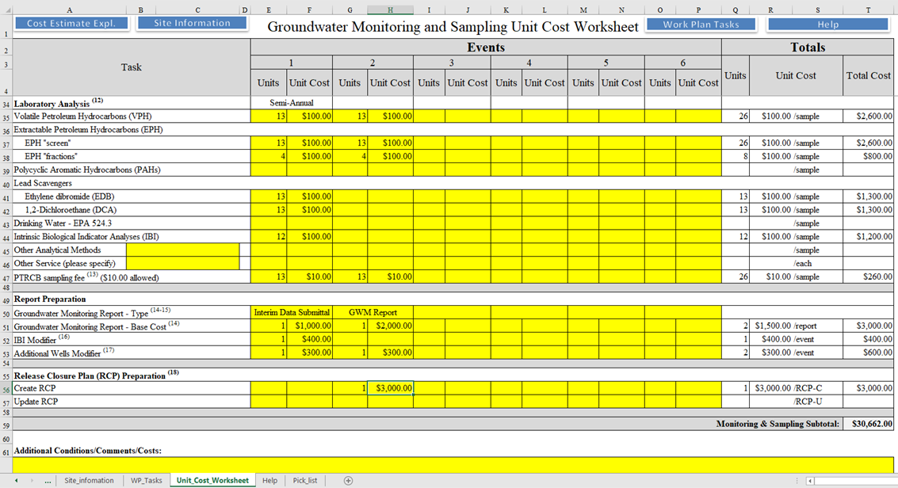

Slide 6
